Slide 1
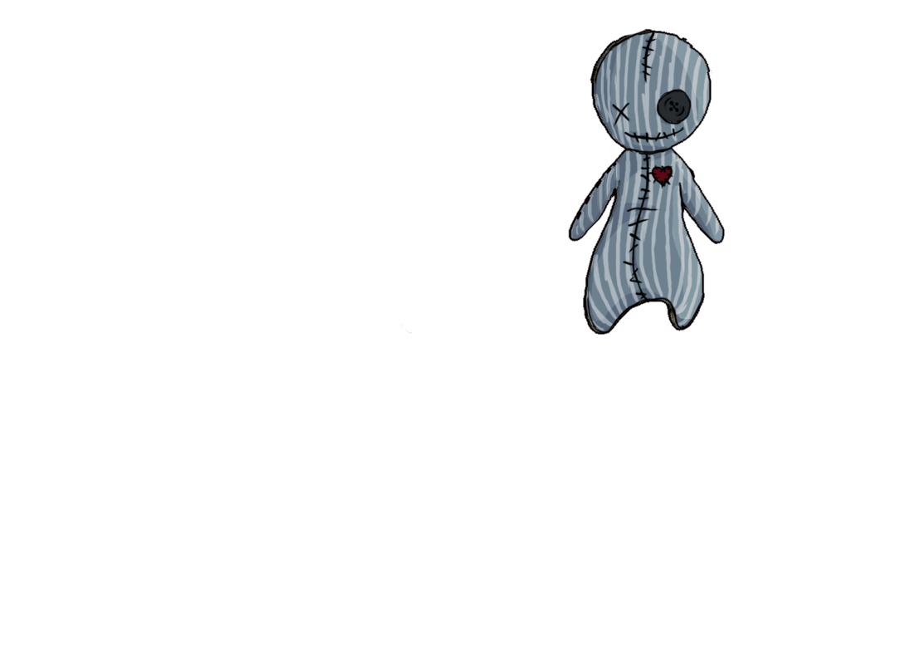
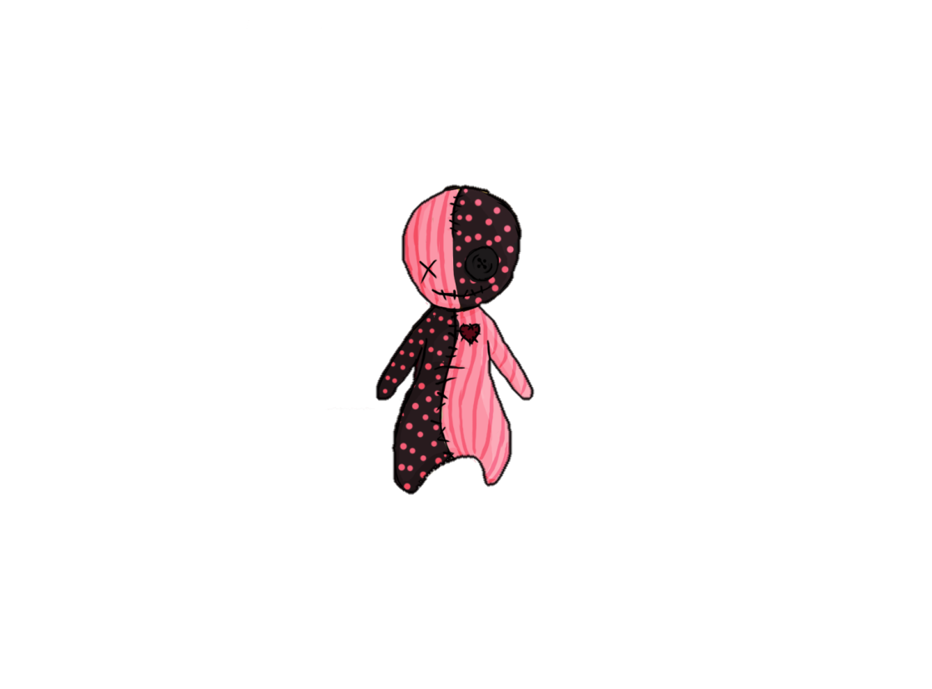


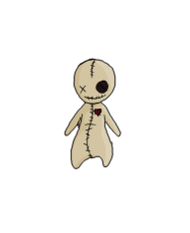
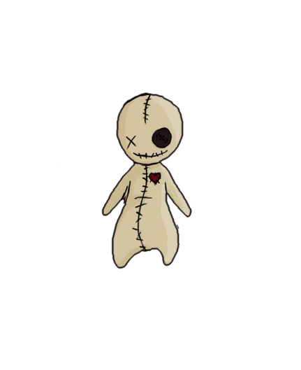








by
1/9
Notes:
Hello and welcome to the Goldmaster presentation of „Doll 13“ made by Team Rex.

Slide 2

Table of Contents
Review
Team Rex
Trailer
Gate 3 Promises vs. Present
Let’s Play!
Questions
2/9
Notes:
First I will give you an overview of what you will see today:
Since many of you don’t know the game at all, I will start with a review of our vision and give you some basic information about the game itself.
After that I will present you the team that made all of this possible and give you a quick overview of what each of them contributed to the game.
Then we will show you our Teaser-Trailer!
Afterwards we will see the goals we had for today and check if we were able to fulfill them and then we will directly dive into the game.
At the end we will then have a Q&A Session.
So, let’s start with the short review.

Slide 3
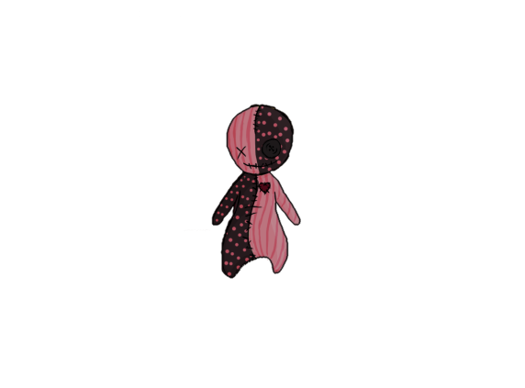

Review
Vision: Doll 13 is a 3D puzzle-adventure for lovers of the occult with minimized stealth-elements.
Game Type: 3D Platformer
Game Mode: Singleplayer
Genre: Mystery Adventure
Platform: PC
Engine: Unity
3/9
Notes:
Doll 13 is a 3D puzzle-adventure for lovers of the occult with minimized stealth-elements. We tried to create a game where you can explore everything at your own pace and where you have to take a look around to be able to grasp the whole story. It’s a singleplayer game for PC where you play a little Voodoo-Doll that came alive in the basement of a secret base and now trys to escape from there. It is set in the 1950s and we wanted to achieve a low-poly look with simplified textures.
Let me introduce our team to you:

Slide 4
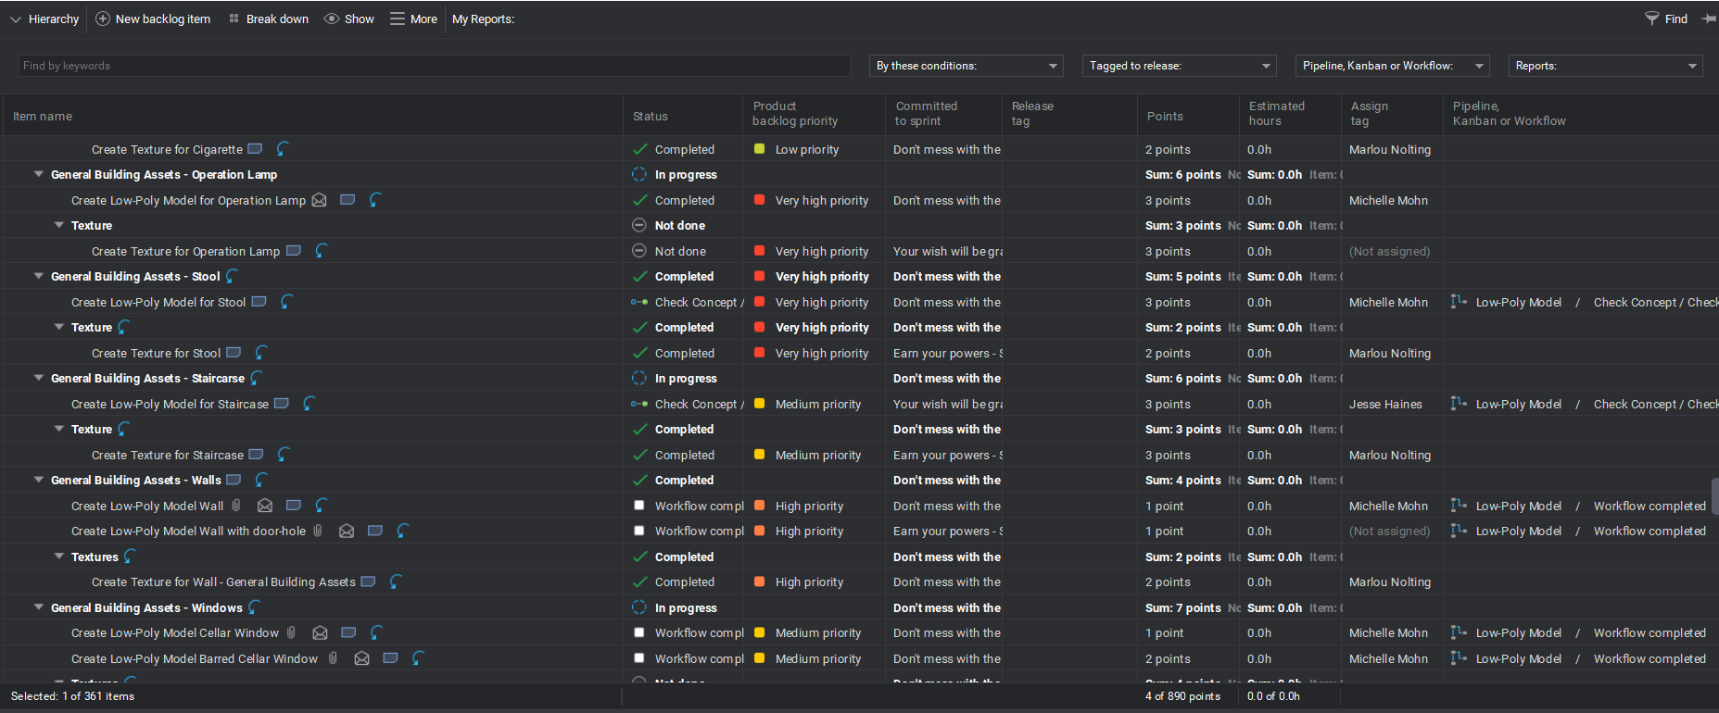
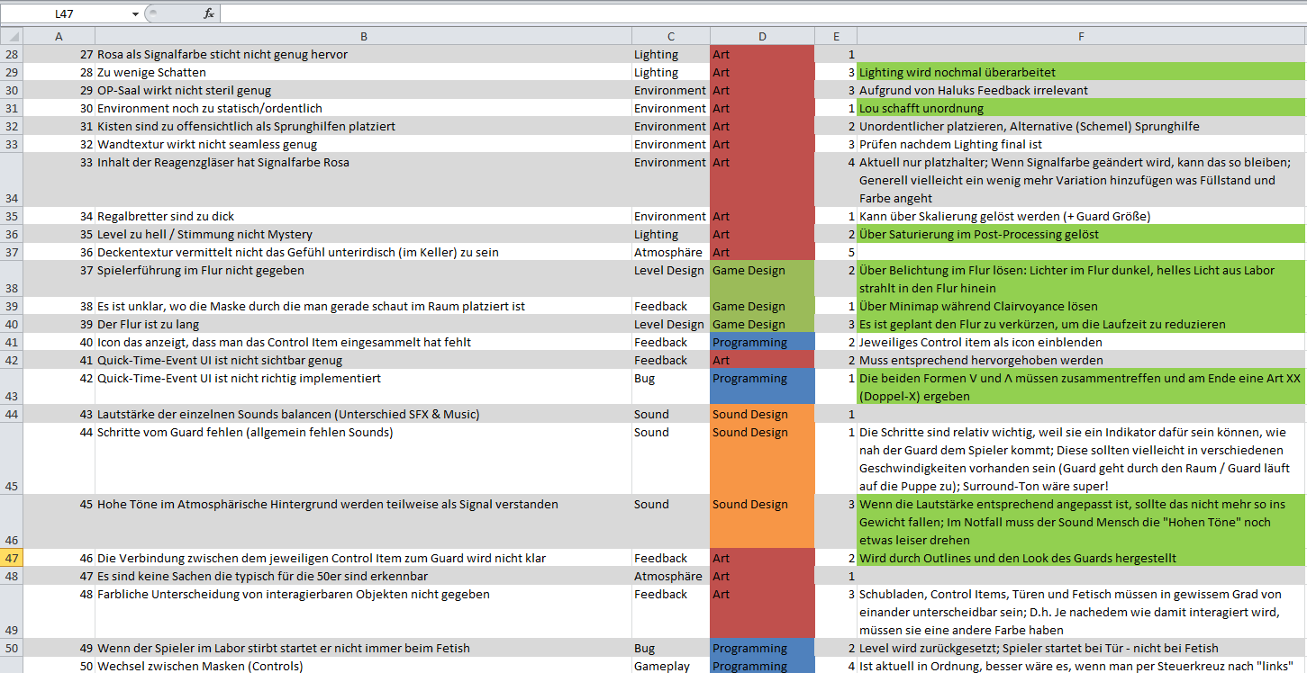
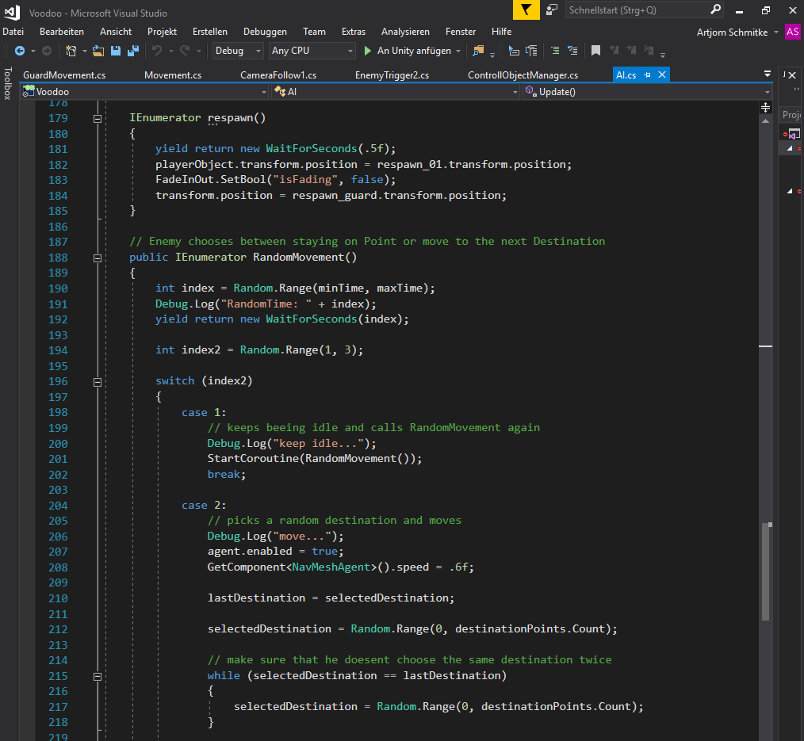

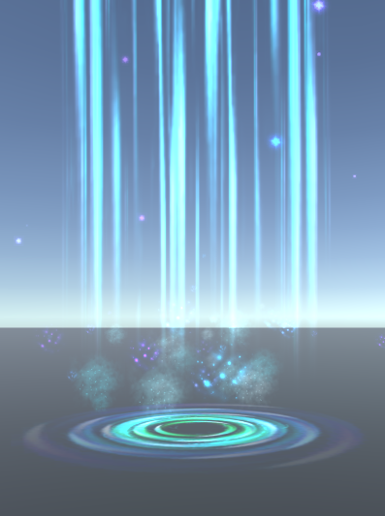
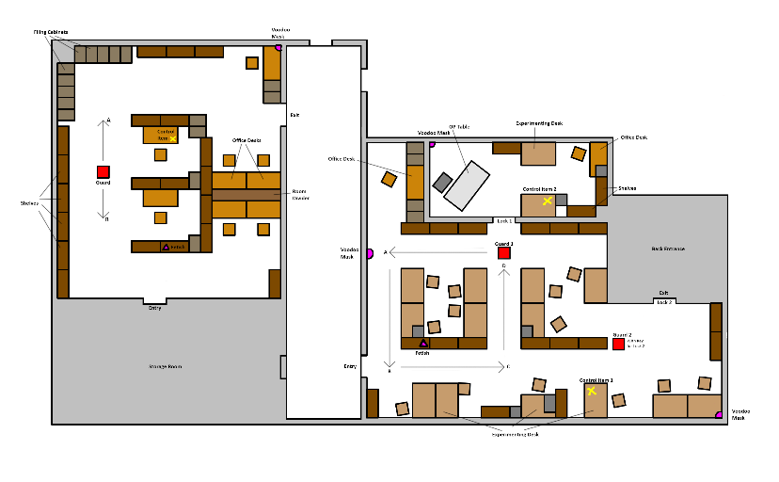
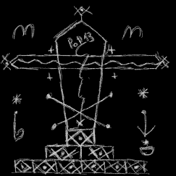

Team Rex
Producer:
Sonja Köck
Programmer:
Artjom Schmitke
Game Designer:
Tobias Schuster
Sound Designer:
Elias Knop
4/9
Notes:
Our Producer, Sonja Koeck, managed the planning throughout the project and helped with the communication within the team. She also created our VFX-Effects for the game.
Our one and only programmer, Artjom Schmitke, coded nearly everything you see in the game and was especially focused on our guards AI.
Apart from designing the gameplay and being vision keeper of the game our Game Designer, Tobias Schuster, also helped out with some code, handling the lighting ingame, creating the minimap and being the producer representative.
We also had external help from the creative sound designer Elias Knop from the Abby Roads Studios. He provided most of the Soundeffects and the Background Sound you can hear within the game.

Slide 5
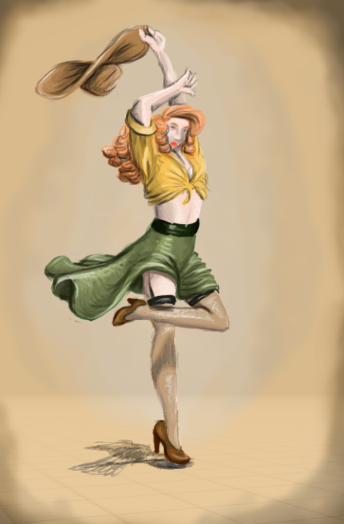
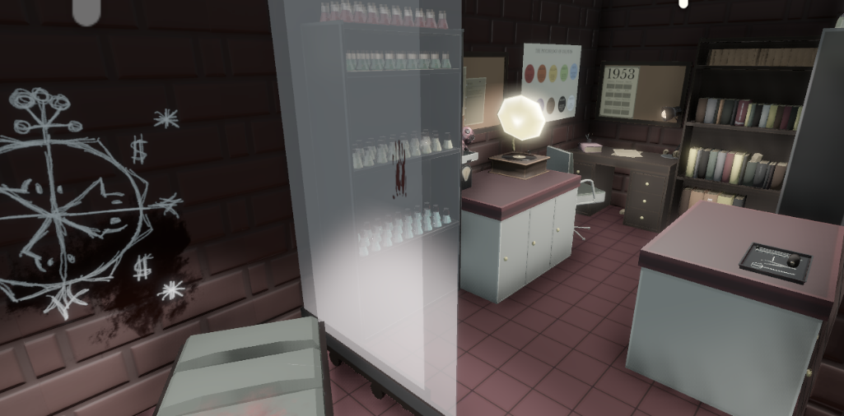
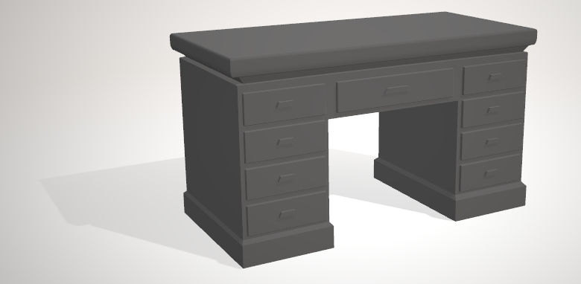
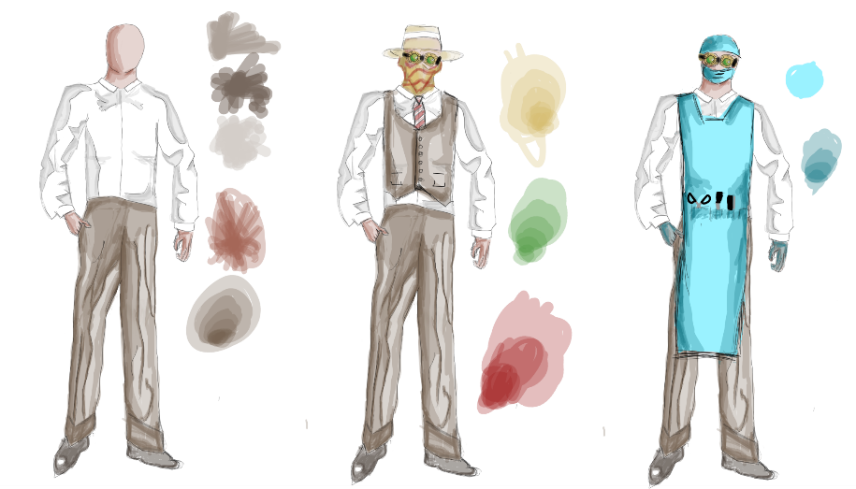
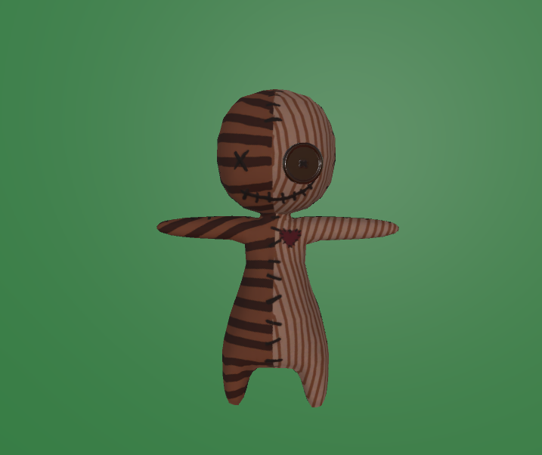
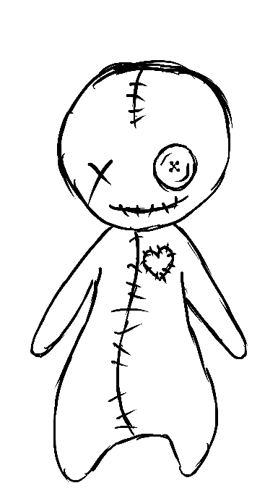
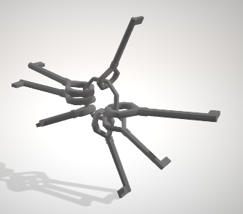
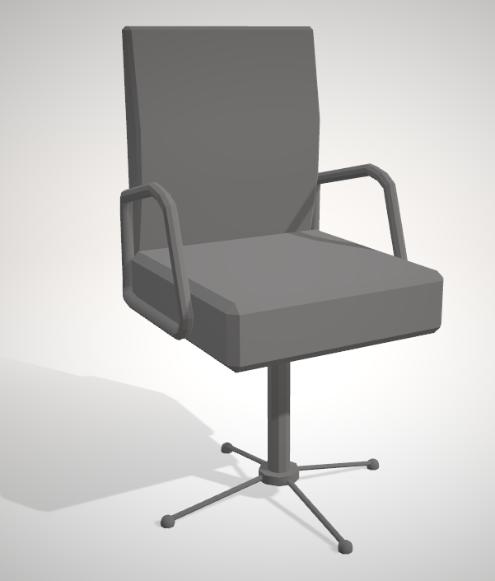
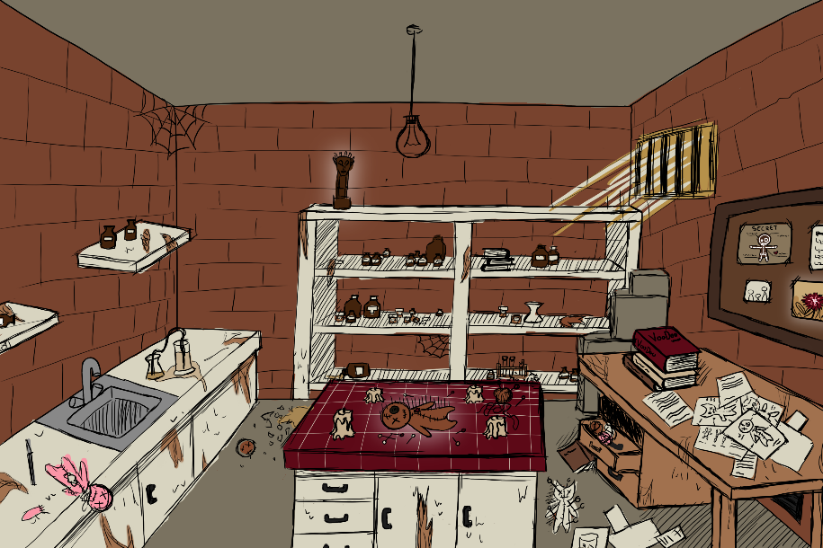
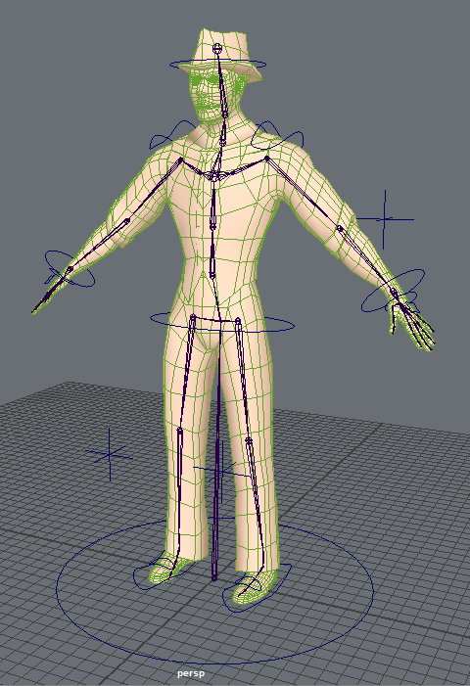
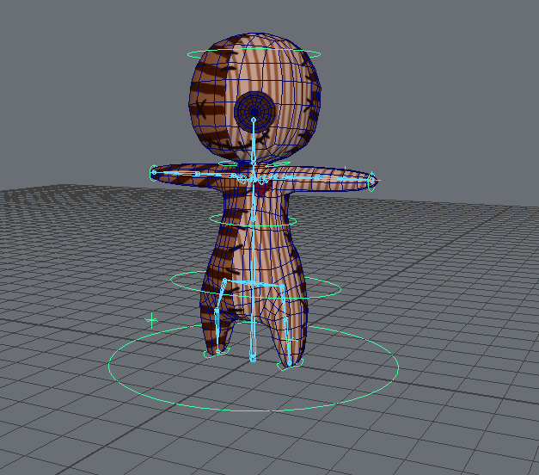
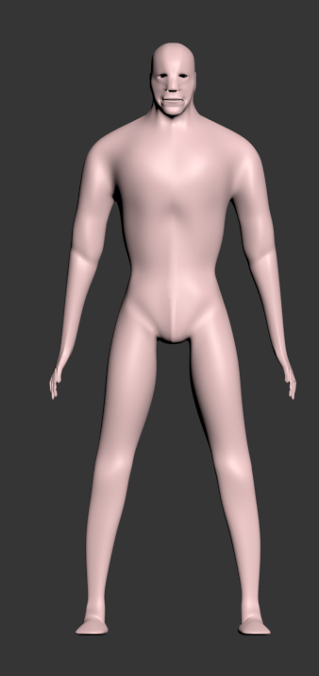
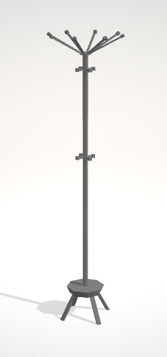
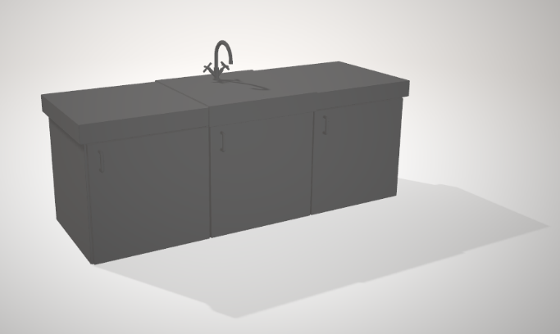
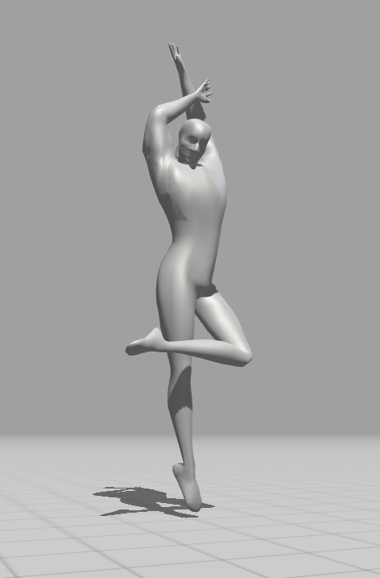
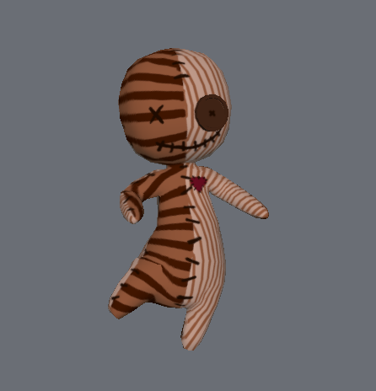
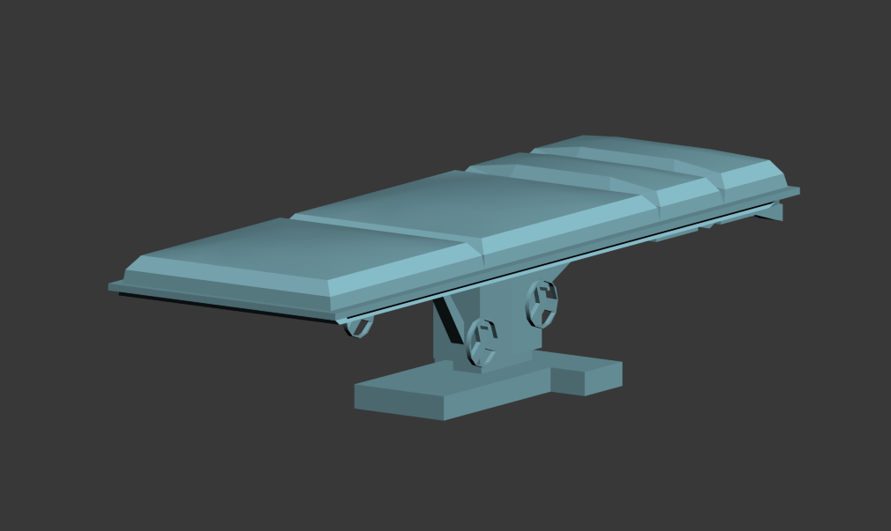
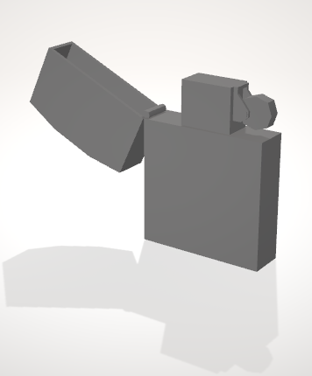
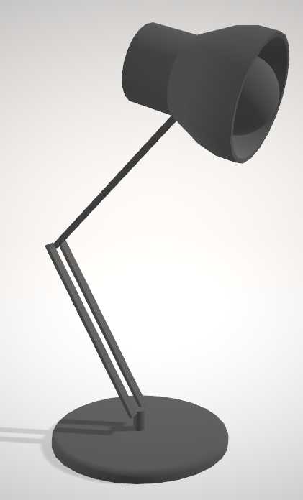
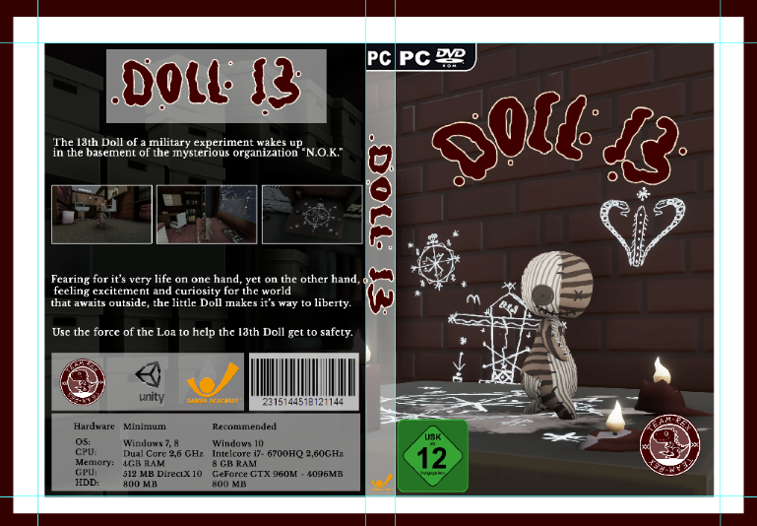
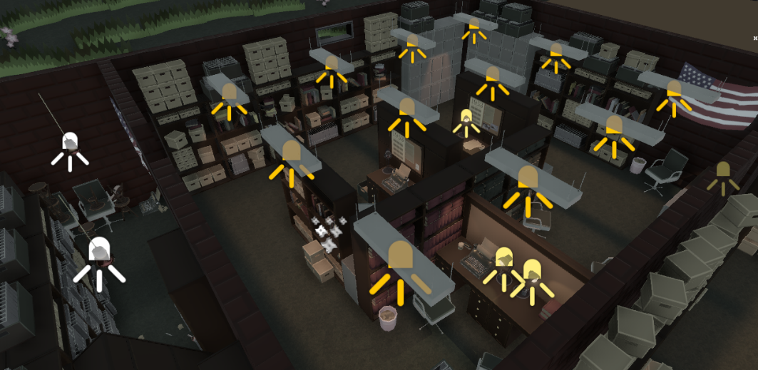
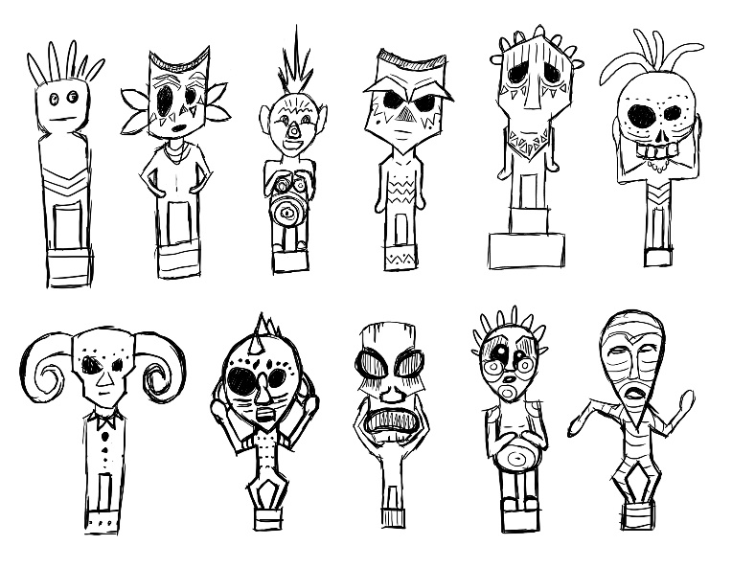

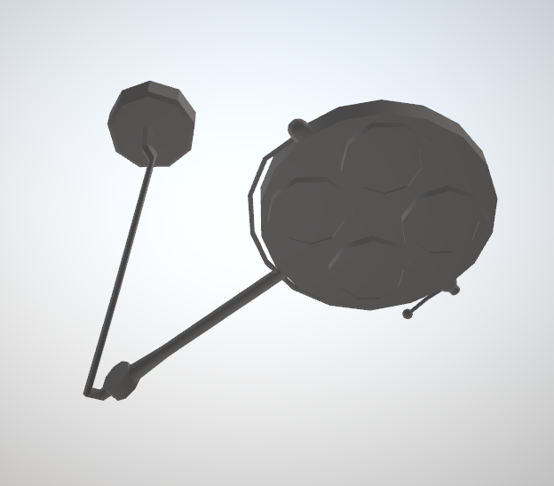
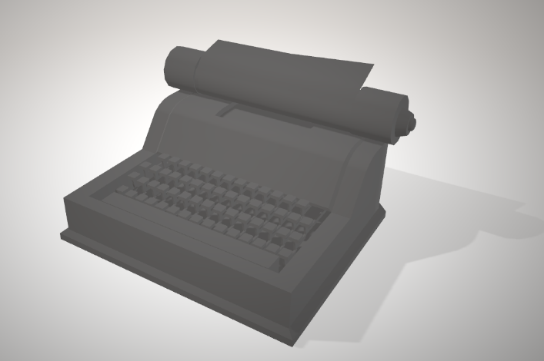
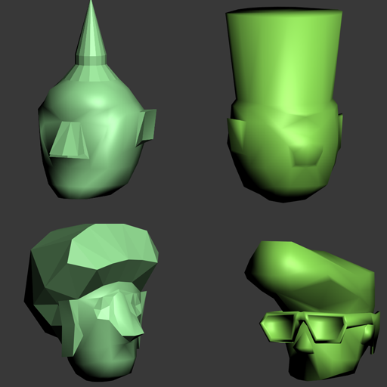
Team Rex
Artists:
Michelle Gaußmann
Jesse Haines
Levin Lang
Michelle Mohn
Marlou Nolting
5/9
Notes:
So now we come to the main part of our team: our artists! Michelle Gaussmann is our animator. Not only did she make the skin, rig and all the animations of our main character…
… she also made a retopology of the guard model, skinned and rigged it and made all the animations for it as well. Since our guard has some really nice legs she also decided to use him as a model for some posters she made for the game.
Jesse Haines is our 3D-Specialist for some of the more complex 3D-models in the game
Levin Lang is our jack-of-all-trades. He provided us with various concepts throughout the production, created the basic body of our guard as well as several 3D assets and decals and also made some small animations for the game.
Michelle Mohn also is very flexible regarding 2D and 3D. She made some nice concepts for our tutorial room and our fetish but mostly created the tons of 3d assets that you can see everywhere in the game.
Marlou Nolting is our lead artist. She created our main character from concept to 3D model but is mainly focusing on 2D. Additionally to creating nearly all textures, she also arranged every item we have within the game to create the atmosphere we have now …. and still found the time to design our cover.

Slide 6
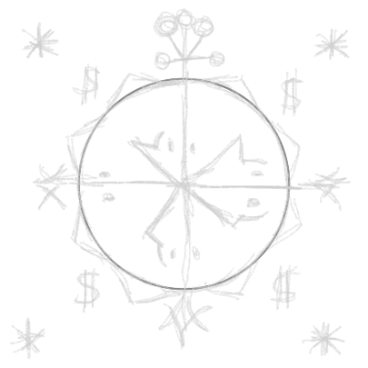
Trailer Time!
6/9
Notes:
What goals did we set us for today:
We promised you will be able to see a tutorial today ….. And were able to keep that promise. The tutorial will be the first room in our game and we will show it to you in just a few minutes.
Also we wanted to have a Menu in our game ….. And this also worked out.
Last but not least we wanted to polish our game and incorporate some of the feedback that we received at our last game. We tried our best in the short time we had since then and hope you like the result as much as we do.

Slide 7

Gate 3
Promise:
Present:
Tutorial
Menu
Polished Game
7/9
Notes:
What goals did we set us for today:
We promised you will be able to see a tutorial today ….. And were able to keep that promise. The tutorial will be the first room in our game and we will show it to you in just a few minutes.
Also we wanted to have a Menu in our game ….. And this also worked out.
Last but not least we wanted to polish our game and incorporate some of the feedback that we received at our last game. We tried our best in the short time we had since then and hope you like the result as much as we do.

Slide 8

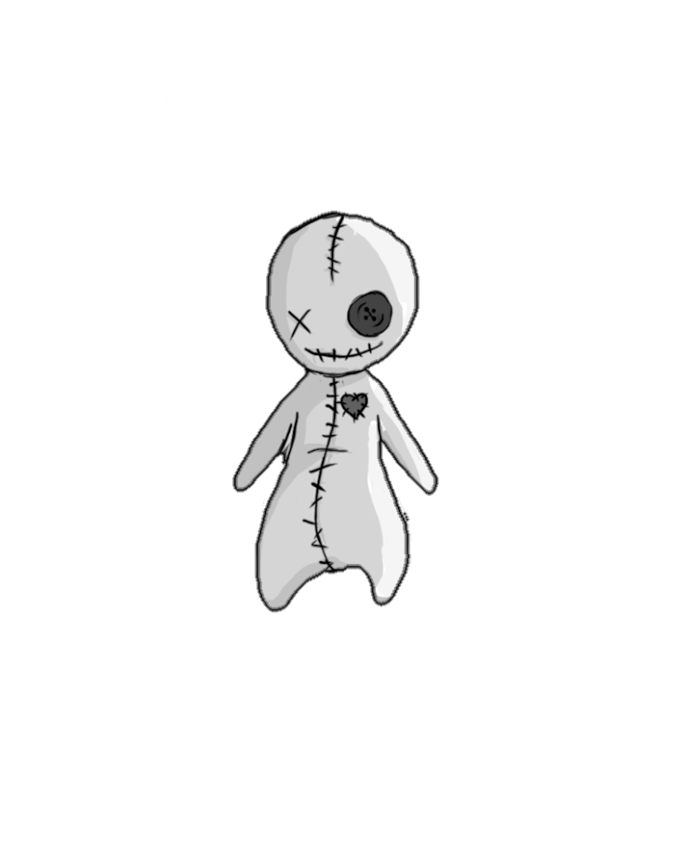
Let’s play!
8/9
Notes:
So without further talking, let’s play Doll 13!

Slide 9

Any Questions?
Team-Rex
Games Academy Frankfurt
Hanauer Landstraße 146
60314 Frankfurt am Main
Sonja.Koeck@games-academy.de
9/9
Notes:
Thank you for listening and watching. If you have any more questions Team Rex will now gladly to answer them . ☺

